Slide 1
Building Community Through Mindfulness and Committed Action
Annette Dufresne, PhD, C.Psych
Windsor, Ontario, Canada.

Slide 2
Einstein
Break free from the optical delusion of consciousness that separates us
from others
Notes:
My own experience in Building Community Through Mindfulness and Committed Action.

Slide 3
Importance of Community and Connection
Power of Mindfulness
Living the Change you Want to See

Slide 4
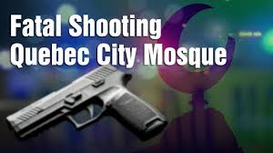
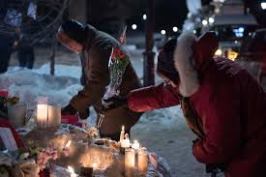
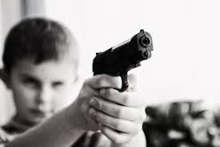
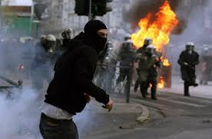
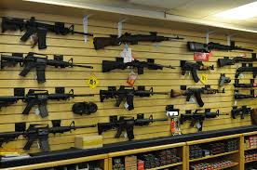
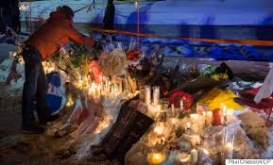
Feeling Overwhelmed?
Notes:
My journey started with my own discomfort with living in a world full of escalating divisiveness, hate-crimes, and increasing toxicity of politics. I wanted to try to put principles that I encourage clients to use into action in my own life.

Slide 5
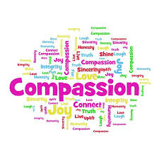
Notes:
I started to consider my core values. Rather than what I was seeing in a lot of the media my core values tend more towards connection and compassion.

Slide 6
Notes:
I started hosting a monthly mindfulness meditation and committed action gathering at my office.

Slide 7
Notes:
The base for our gathering was to practice mindfulness meditation. For me, the draw of mindfulness is to be able to engage more fully in each moment. And the non-judgmental compassionate approach to this practice is also appealing.

Slide 8
Mindful Connections
Notes:
Group practice adds a different kind of energy to the practice, and highlights the point made in the opening quote around appreciating the delusional quality in our sense of being separate from others. We named our group Mindful Connections.

Slide 9
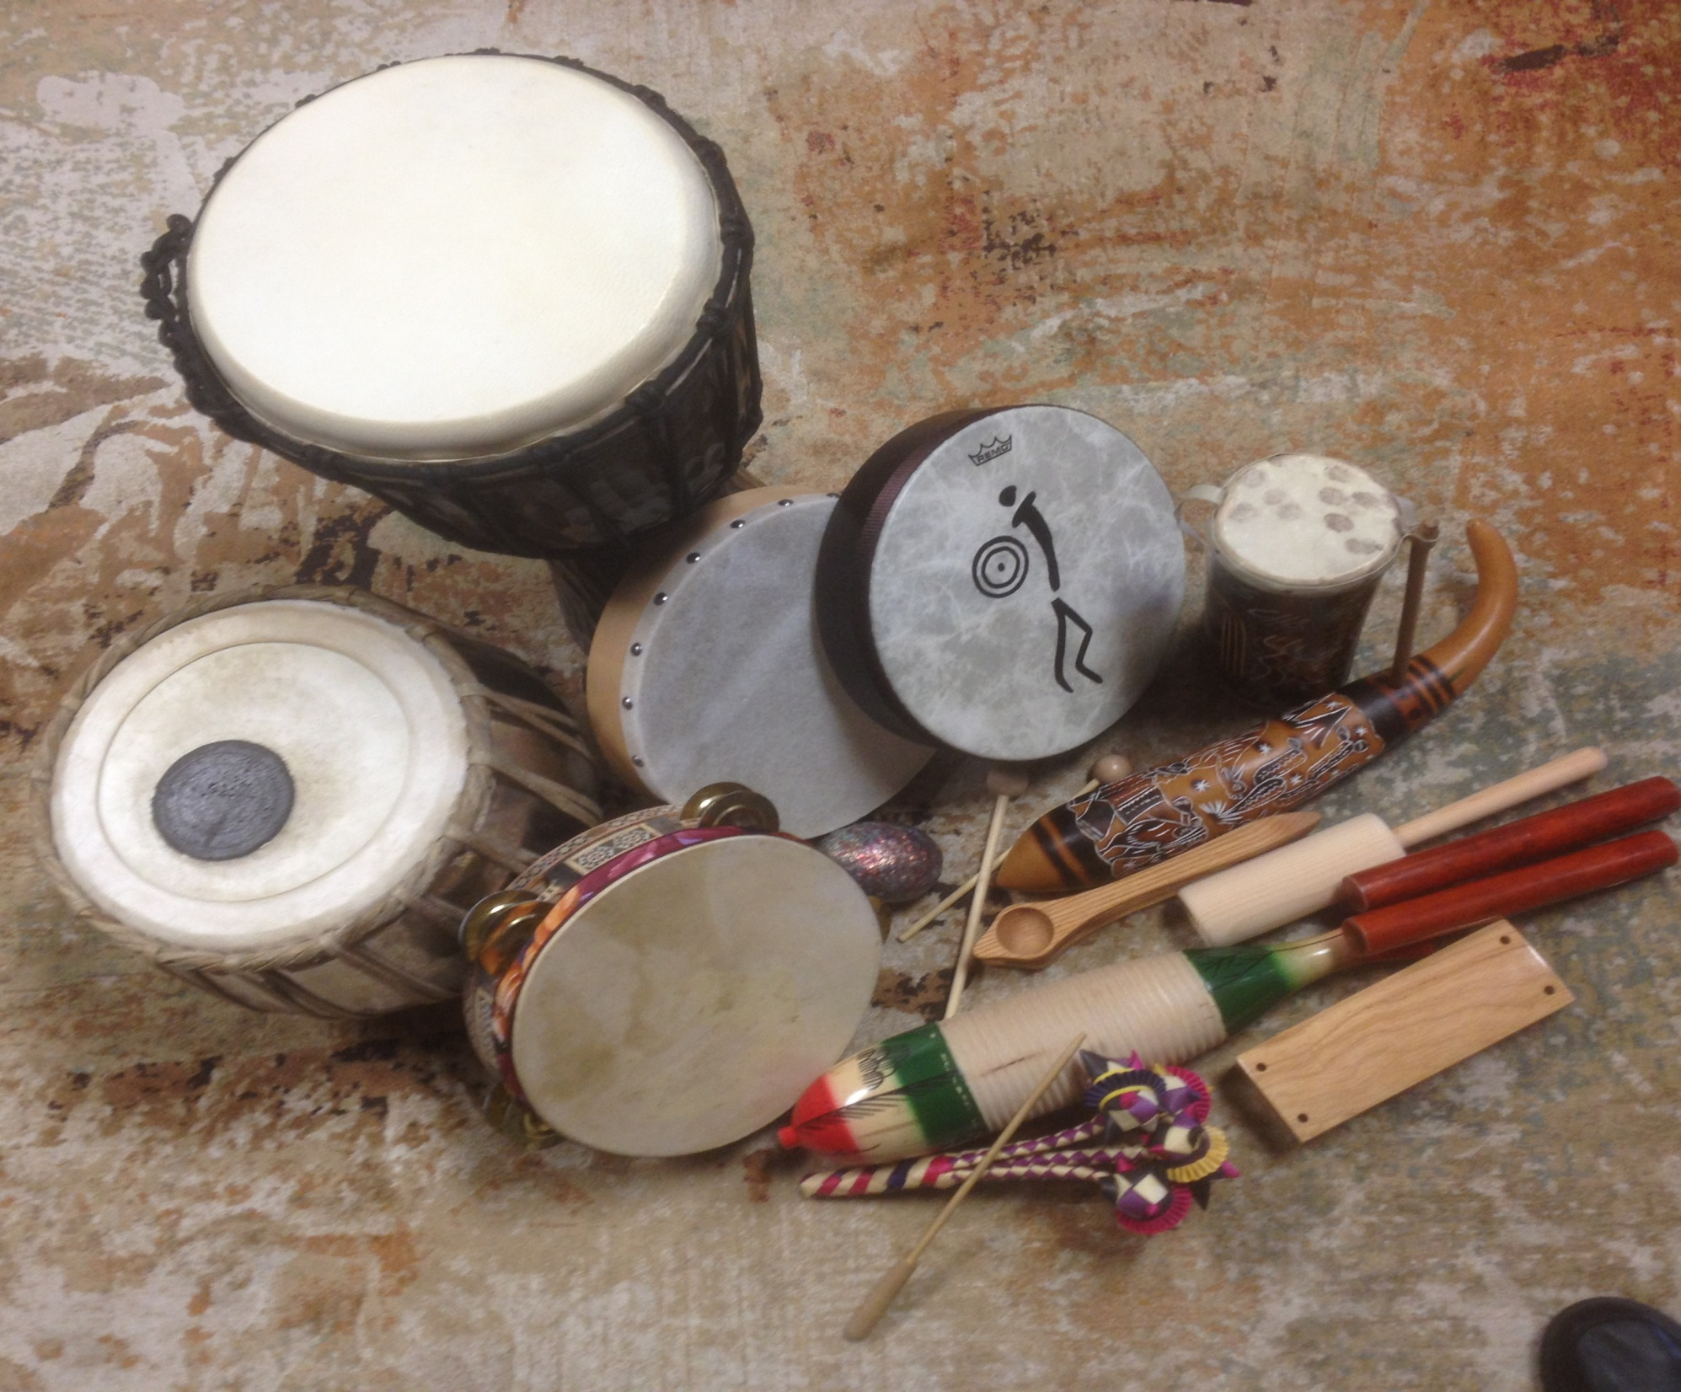
(photo of drums)
Notes:
We have also experimented with the use of drumming and chanting as meditation tools.

Slide 10
Mindful Eating
Notes:
Having an opportunity to practice mindful eating and some time for conversation added a new dimension to our community gathering.

Slide 11
Notes:
In the spirit of extending a mindful approach into one´s life and working towards committed action, I accept free-will donations to be donated to a charity of the group’s choosing.

Slide 12
Notes:
Charities we have donated to have included: homeless shelters and drop-in centres, local organizations that support refugees that have recently resettled in our community, domestic violence shelters, youth centres, local mental health agencies, environmental organizations,

Slide 13
Notes:
Some people would select a charity that had touched their own lives in some way, such as the Cancer Society, Alzheimer´s Society, or the Huntington´s Disease Society. It seems as if the one that is picked for that month is always a good fit.
.

Slide 14
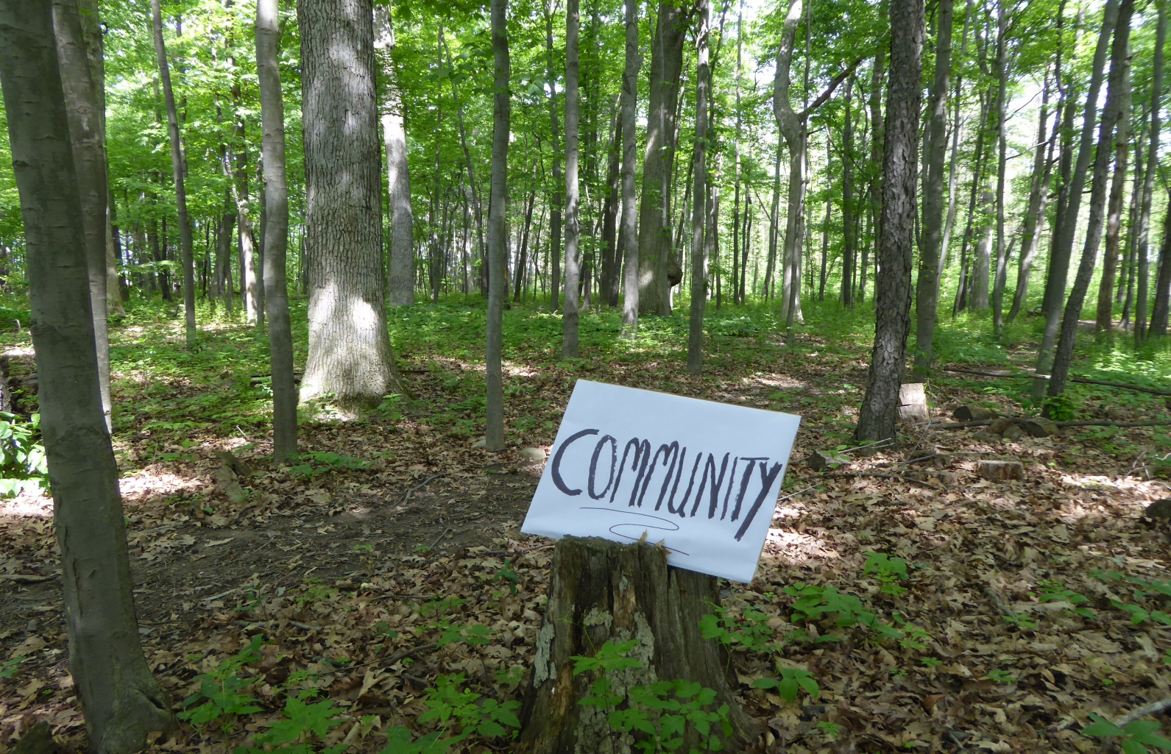
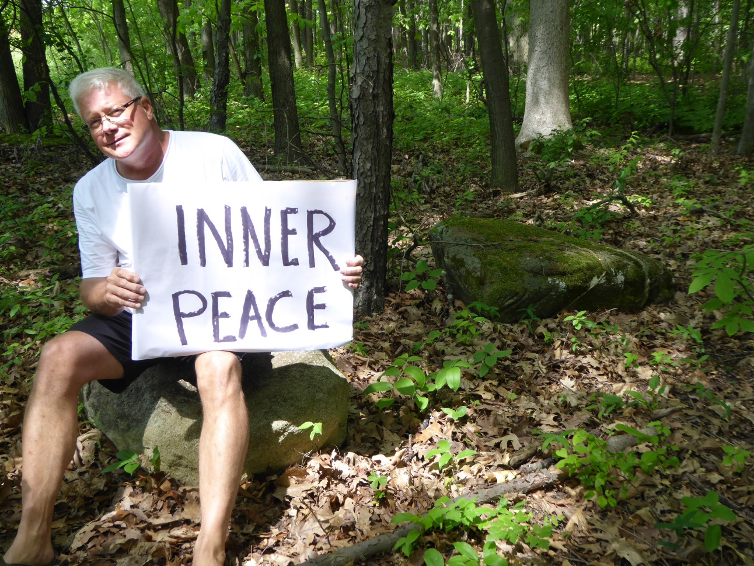

Slide 15
Notes:
A couple of group members wrote short poems or Haiku poems. One wrote: Meditation. Pathway to light Shadows beneath a rainbow.

Slide 16
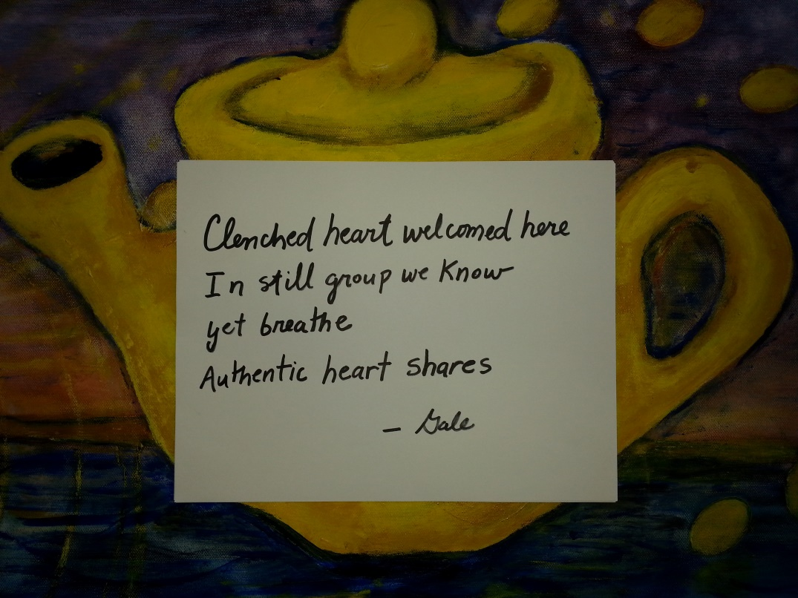
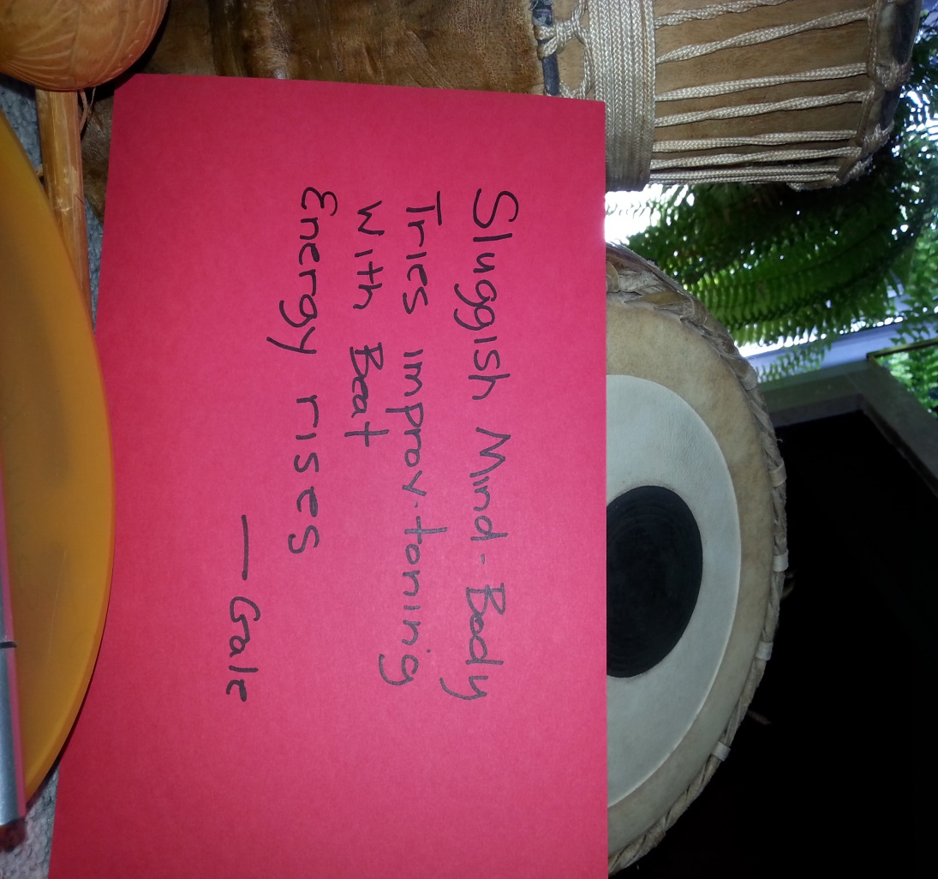
Notes:
Another wrote some Haikus.

Slide 18
Feel free to take what you like…
Notes:
I welcome any of you to take part or all of this idea and start something similar in your own community.

Slide 19
Perhaps we can start a little network of such groups and connect on-line periodically. Feel free to contact me at dradufresne@gmail.com.

Slide 20
Importance of Community and Connection
Power of Mindfulness
Living the Change you Want to See

